Slide 1
Computational Complexity

Slide 2
What’s important about Computational Complexity?

Slide 3
Why complexity?
We have to decide between algorithm A and algorithm B
We have a dataset for benchmarking algorithms with about 1,000 rows
What should we do?
 | Algo A | Algo B
Time on lab data | 5s | 30s

Slide 4
Why complexity?
We have to decide between algorithm A and algorithm B
We have a dataset for benchmarking algorithms with about 1,000 rows
What should we do?
This depends on what kinds of data the algorithms will be given in production
What if we’ll be running it on 100k rows?
 | Algo A | Algo B
Time on lab data | 5s | 30s

Slide 5
Why complexity?
We have to decide between algorithm A and algorithm B
We have a dataset for benchmarking algorithms with about 1,000 rows
What should we do?
This depends on what kinds of data the algorithms will be given in production
What if we’ll be running it on 100k rows?
What if we had a formula that told us the runtime for different size inputs?
 | Algo A | Algo B
Time on lab data | 5s | 30s

Slide 6

Why complexity?
We have to decide between algorithm A and algorithm B
What should we do?
What if we had a formula that told us the runtime for different size inputs?
$t_{a}\left(n\right)=5∗{\left(\frac{n}{1000}\right)}^{2}$
$t_{b}\left(n\right)=29+\left(\frac{n}{1000}\right)$
 | Algo A | Algo B
1k | 5s | 30s
Notes:
Ask students what the runtime will be for 10k rows

Slide 7

Why complexity?
We have to decide between algorithm A and algorithm B
What should we do?
What if we had a formula that told us the runtime for different size inputs?
$t_{a}\left(n\right)=5∗{\left(\frac{n}{1000}\right)}^{2}$
$t_{b}\left(n\right)=29+\left(\frac{n}{1000}\right)$
Now we can know the runtime for any size input
 | Algo A | Algo B
1k | 5s | 30s
10k | 500s | 39s
Notes:
Ask students what the runtime will be for 100k rows

Slide 8
Why complexity?
We have to decide between algorithm A and algorithm B
What should we do?
What if we had a formula that told us the runtime for different size inputs?
$t_{a}\left(n\right)=5∗{\left(\frac{n}{1000}\right)}^{2}$
$t_{b}\left(n\right)=29+\left(\frac{n}{1000}\right)$
Now we can know the runtime for any size input
 | Algo A | Algo B
1k | 5s | 30s
10k | 500s | 39s
100k | 13.9 hours | 49s
Notes:
Which algorithm would they pick now?

Slide 9
Complexity Defined
Complexity: An algorithm’s complexity is a measure of the resources it uses
Most common is time complexity
In a few weeks, we will discuss space complexity (memory use)
Notes:
Which algorithm would they pick now?

Slide 10
Complexity Defined
Complexity: An algorithm’s complexity is a measure of the resources it uses
Most common is time complexity
Another important measure we won’t discuss is space complexity (memory use)
Time complexity can be measured in several ways
Wall clock measures amount of time that passes while the algorithm runs
Imminently useful
However, sensitive to details about hardware and implementation like processor core speed and parallelization
Notes:
Which algorithm would they pick now?

Slide 11
Complexity Defined
Complexity: An algorithm’s complexity is a measure of the resources it uses
Most common is time complexity
In a few weeks, we will discuss space complexity (memory use)
Time complexity can be measured in several ways
Wall clock measures amount of time that passes while the algorithm runs.
Imminently useful
However, sensitive to details about hardware and implementation like processor core speed and parallelization
Compute time measures the computations made during the algorithm’s execution
ex: number of comparisons, processor cycles
Relevant across different hardware setups and implementations
Notes:
Which algorithm would they pick now?

Slide 12
Introducing Big-O Notation

Slide 13
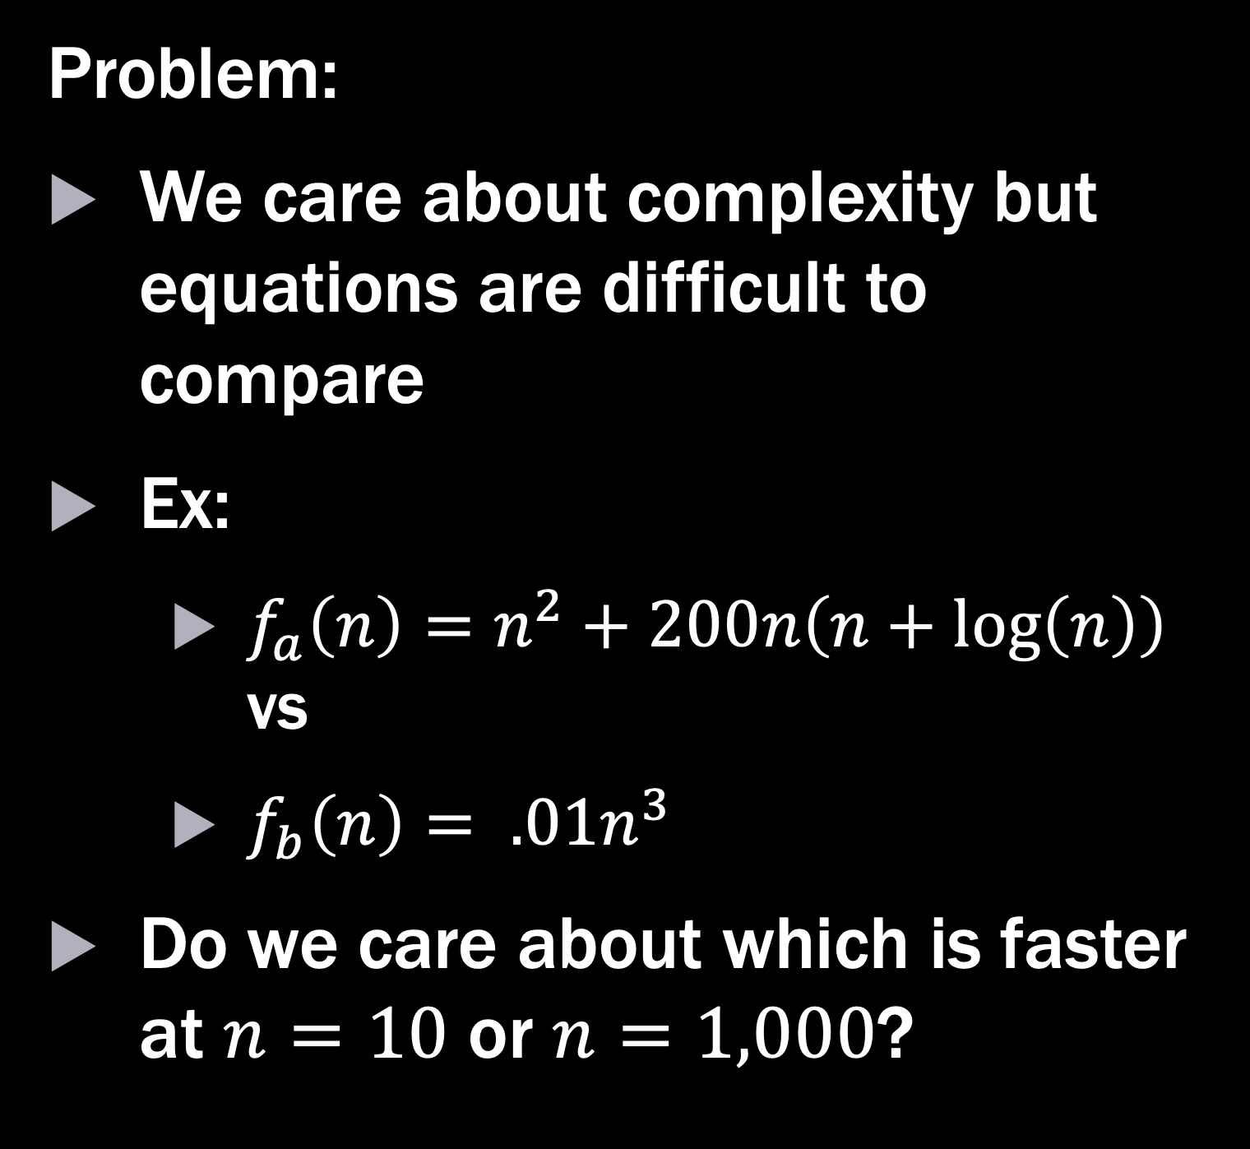
Big-O
Problem:
We care about complexity but equations are difficult to compare
Ex:
$f_{a}\left(n\right)=n^{2}+200n\left(n+\log\left(n\right)\right)$ vs
$f_{b}\left(n\right)= .01n^{3}$
Do we care about which is faster at $n=10$ or $n=1,000$?

Slide 14
Big-O
Problem:
We care about complexity but equations are difficult to compare
Ex:
$f_{a}\left(n\right)=n^{2}+200n\left(n+\log\left(n\right)\right)$ vs
$f_{b}\left(n\right)= .01n^{3}$
Do we care about which is faster at $n=10$ or $n=1,000$?
Solution
Big-O notation simplifies comparisons of computational resources

Slide 15
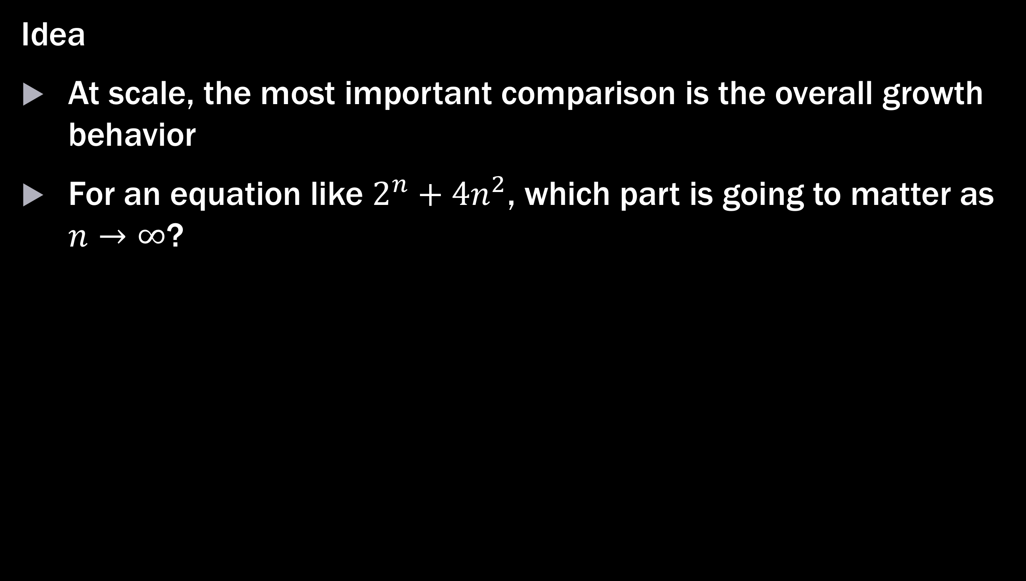
Big-O
Idea
At scale, the most important comparison is the overall growth behavior
For an equation like $2^{n}+4n^{2}$, which part is going to matter as $n→∞$?
Notes:
Let students answer this

Slide 16

Big-O
Idea
At scale, the most important comparison is the overall growth behavior
For an equation like $2^{n}+4n^{2}$, which part is going to matter as $n→∞$?
Complexity equations
$$2n!$$
$$2^{n}+4n^{2}$$
$$n^{100}+3$$
$$n^{2}+n$$

Slide 17
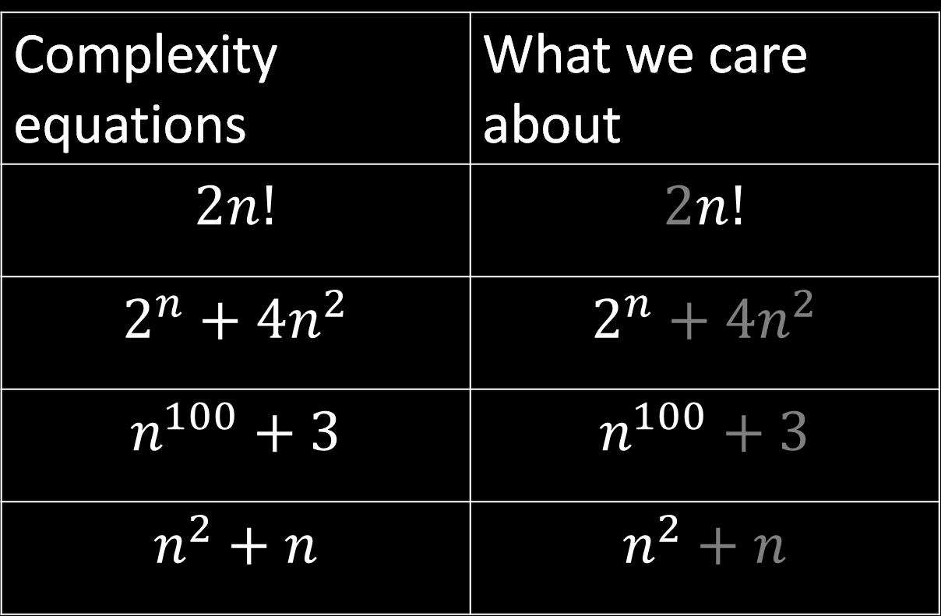
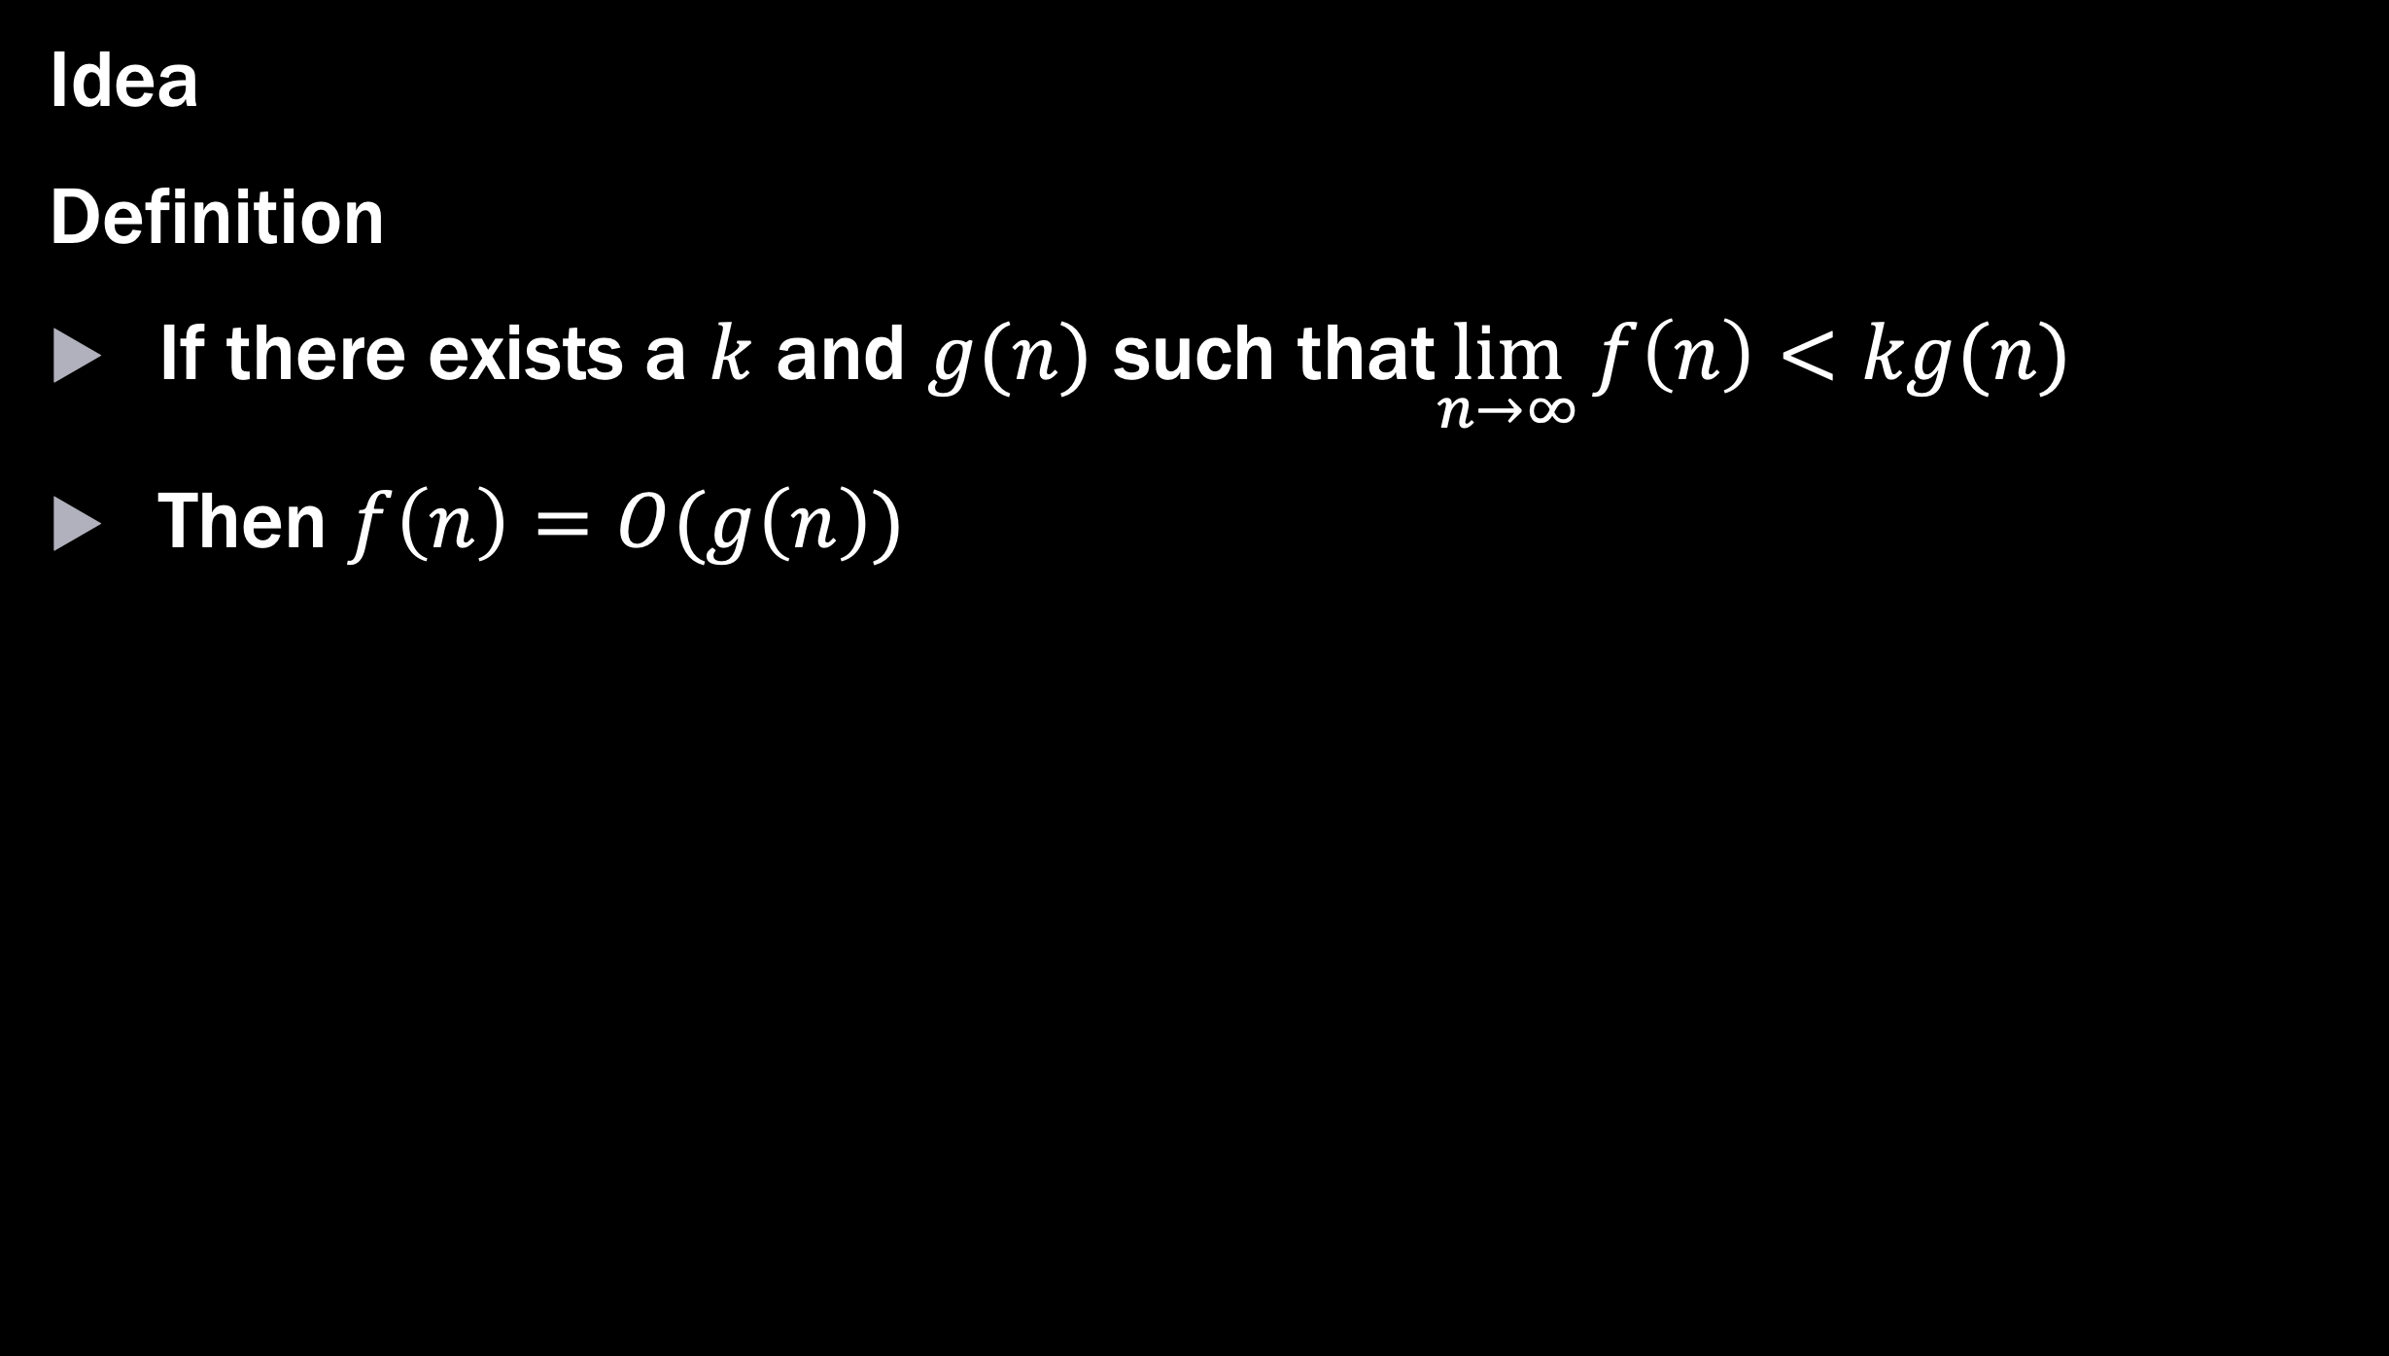
Big-O
Idea
Definition
If there exists a $k$ and $g(n)$ such that$\lim_{n→∞}{f\left(n\right)<kg(n)}$
Then $f\left(n\right)=O(g\left(n\right))$
Complexity equations | What we care about
$$2n!$$ | $$2n!$$
$$2^{n}+4n^{2}$$ | $$2^{n}+4n^{2}$$
$$n^{100}+3$$ | $$n^{100}+3$$
$$n^{2}+n$$ | $$n^{2}+n$$

Slide 18
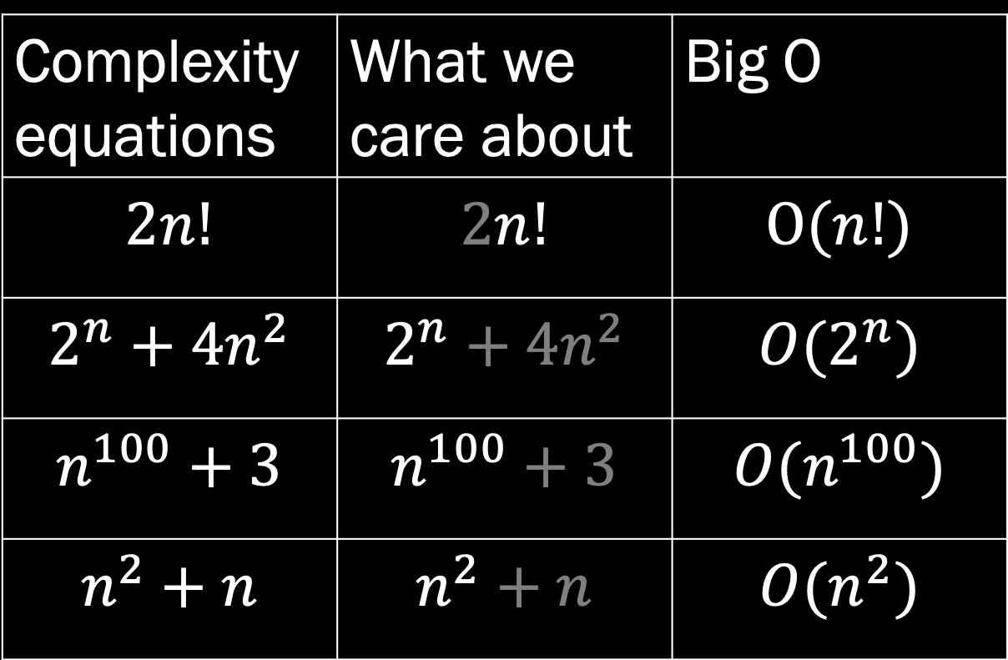
Big-O
Idea
Definition
If there exists a $k$ and $g(n)$ such that$\lim_{n→∞}{f\left(n\right)<kg(n)}$
Then $f\left(n\right)=O(g\left(n\right))$
Complexity equations | What we care about | Big O
$$2n!$$ | $$2n!$$ | $$O(n!)$$
$$2^{n}+4n^{2}$$ | $$2^{n}+4n^{2}$$ | $${O(2}^{n})$$
$$n^{100}+3$$ | $$n^{100}+3$$ | $$O(n^{100})$$
$$n^{2}+n$$ | $$n^{2}+n$$ | $${O(n}^{2})$$

Slide 19
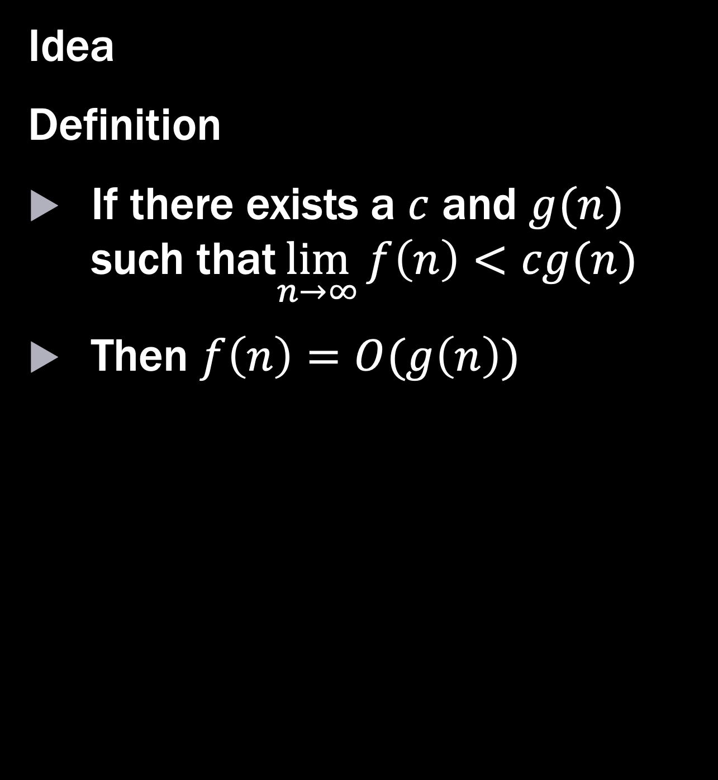
Big-O
Idea
Definition
If there exists a $c$ and $g(n)$ such that$\lim_{n→∞}{f\left(n\right)<cg(n)}$
Then $f\left(n\right)=O(g\left(n\right))$
Complexity equations | What we care about | Big O
$$2n!$$ | $$2n!$$ | $$O(n!)$$
$$2^{n}+4n^{2}$$ | $$2^{n}+4n^{2}$$ | $${O(2}^{n})$$
$$n^{100}+3$$ | $$n^{100}+3$$ | $$O(n^{100})$$
$$n^{2}+n$$ | $$n^{2}+n$$ | $${O(n}^{2})$$

Slide 20
Finding Big-O

Slide 21
Using heuristics to find Big-O
Heuristic workflow
Find expression
(more on how to find the expression in the notebook section)
Simplify expression
Only keep highest order term
Discard constants

Slide 22
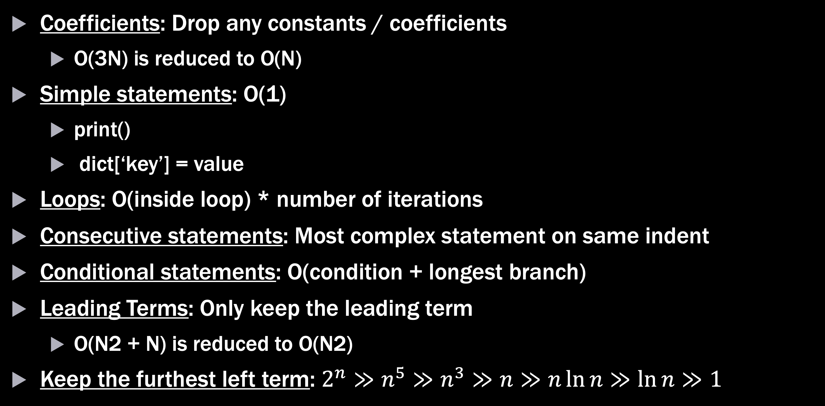
Heuristics Cheat Sheet
Coefficients: Drop any constants / coefficients
O(3N) is reduced to O(N)
Simple statements: O(1)
print()
dict[‘key’] = value
Loops: O(inside loop) * number of iterations
Consecutive statements: Most complex statement on same indent
Conditional statements: O(condition + longest branch)
Leading Terms: Only keep the leading term
O(N2 + N) is reduced to O(N2)
Keep the furthest left term: $2^{n}≫n^{5}≫n^{3}≫n≫n\ln{n}≫\ln{n}≫1$

Slide 23

Finding Big-O (you try it)
Find the big-O complexity for:
$$f\left(n\right)=n(2n+\sin\left(n\right))$$

Slide 24

Finding Big-O
Find the big-O complexity for:
$$f\left(n\right)=n\left(2n+\sin\left(n\right)\right)$$
$→2n^{2}+n\sin{(n)}$ [simplify]
$→2n^{2}$ [keep highest order term]
$→n^{2}$ [discard coefficients]
$$f\left(n\right)=O(n^{2})$$

Slide 25
Takeaways
Computational Complexity allows us to evaluate an algorithm’s resource use
Big-O notation is a tool for summarizing complexity in a useful way
The Big-O complexity for an algorithm can be solved formally using proofs or informally using heuristics

Slide 27
Extras

Slide 28
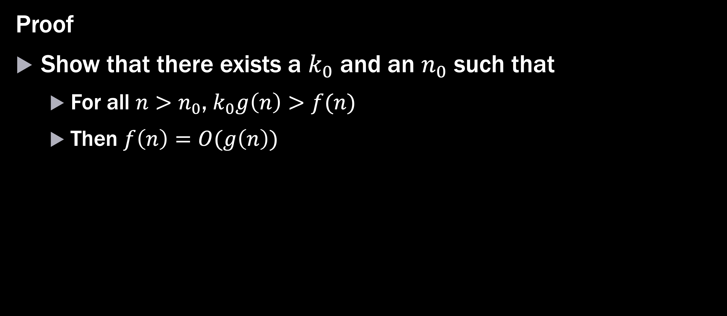
Method 2: Proof
Proof
Show that there exists a $k_{0}$ and an $n_{0}$ such that
For all $n>n_{0}$, $k_{0}g\left(n\right)>f(n)$
Then $f\left(n\right)=O(g\left(n\right))$

Slide 29

Method 2 (you try it)
Use a proof to find the big-O complexity of:
$$f\left(n\right)= \frac{1}{2}\left(2^{n}\right)−3n$$
Let $g\left(n\right)=2^{n}$
$$k2^{n}> \frac{1}{2}\left(2^{n}\right)−3n$$
$$k> \frac{1}{2}−\frac{3n}{2^{n}}$$
True for $k=.5, n>3$, therefore $f\left(n\right)=O(2^{n})$ $∎$

